Slide 1
Investment Prediction

Slide 2
Abstract
Time series forcasting has been widely used to determine the future prices of stock and the analysis and modelling of finance time series importantly guide investors decisions and trades.
This work proposes an intelligeny time series prediction system that uses sliding window optimization for the purpose of predicting the stock prices.
The system has a graphical user interface and functions as a stand alone application.
The proposed model is a promising predictive techquine for highly nonlinear time series, whose patterns are difficult to capture by traditional models.

Slide 3
Objective:
Development of a predictive model for monitoring and predicting stock market prediction
The model will determine whether a customer is placing a fraudulent insurance claim or not.
Benefits:
Detection of upcoming stock prediction.
Gives better insight of stocks.
Helps in easy flow for managing resources.
Manual inspection if fraud is identified .

Slide 4
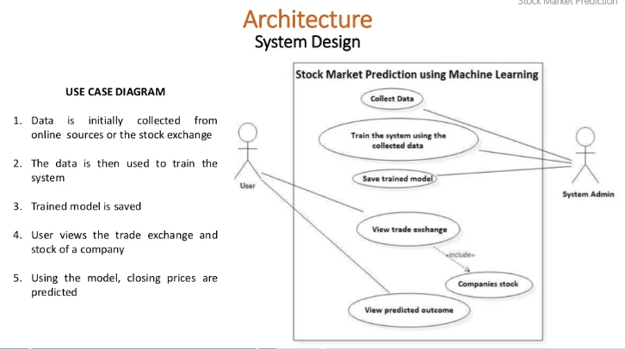

Slide 5
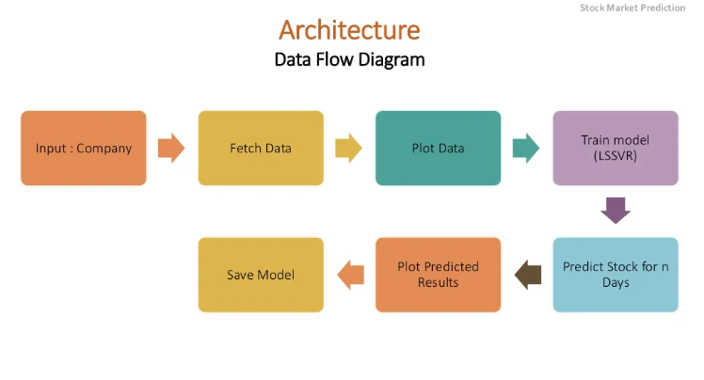

Slide 6
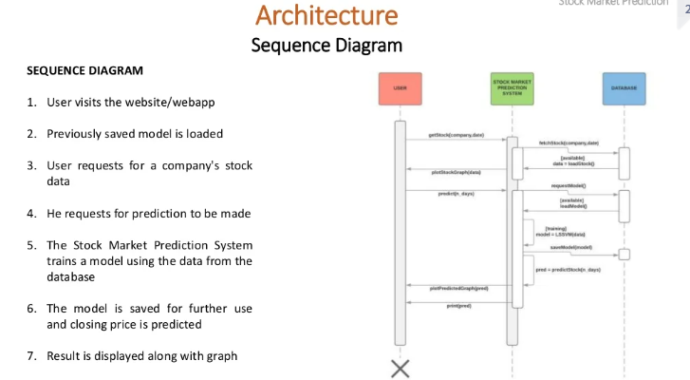

Slide 7
Proposed System :
To generalize the application of the existing system, our work uses the system to estimate other stocks in similar emerging markets and mature markets.
The system can be extended to analyze multivariate time series data and import raw dataset directly.
Profit can be maximized even when the corporate stock market has lower market.
The development of the web based application has been considered to improve the user friendliness and usability of the expert system.

Slide 8
Machine Learning In Stock Predicions
The field of machine learning is vast and plays a key role in a wide range of critical applications.
The concept of support vector machines have advanced features that are reflected in their good generalization capacity and fast computation.
Predicting the stock market involves predicting the closing price of the company’s stock for any given number of days ahead.
SVM can be used to perform linear regression on previous stock data to predict the closing prices using time series forecasting and other optimization algorithms.

Slide 9
Time series analysis –
Time series analysis makes prediction by analyzing observed points in the series.
Time series analysis is an important tool in many stock market prediction methods, As one of the most widely used linear time series forecasting methods, AR and MA.
Model Selection –
After the time series analysis, we find the best model for each cluster. By using Random forest Regressor algorithms.

Slide 10
Prediction:
The testing files are shared in the batches and we perform the same Validation operations ,data transformation and data insertion on them.
The accumulated data from db is exported in csv format for prediction
We perform data pre-processing techniques on it.
Random Forest regressor model created during training is loaded and clusters for the preprocessed data is predicted.
hybrid model for stock price/performance prediction using numerical analysis of historical stock prices and sentimental analysis.

Slide 11
Q & A:
Q1) What’s the source of data?
The data for training is provided by the client in multiple batches and each batch contain multiple files
Q 2) What was the type of data?
The data was the combination of numerical and Categorical values.
Q 3) What’s the complete flow you followed in this Project?
Refer slide 5th for better Understanding

Slide 12
Q 4) How logs are managed?
We are using different logs as per the steps that we follow in validation and modeling like File validation log, Data Insertion, Model Training log , prediction log etc.
Q 5) What techniques were you using for data pre-processing?
Removing unwanted attributes
Visualizing relation of independent variables with each other and output variables
Checking and changing Distribution of continuous values
Removing outliers
Cleaning data and imputing if null values are present.
Converting categorical data into numeric values.
Scaling the data

Slide 13
Q 6) How training was done or what models were used?
Before diving the data in training and validation set we performed clustering over fit to divide the data into clusters.
As per cluster the training and validation data were divided.
The scaling was performed over training and validation data
Algorithms like SVM , XGBoost were used based on the recall final model was used for each cluster and we saved that model .
Q 7) How Prediction was done?
The testing files are shared by the client .We Perform the same life cycle till the data is clustered .Then on the basisof cluster number model is loaded and perform prediction. In the end we get the accumulated data of predictions.

Slide 14
Thank YOU

